Slide 1
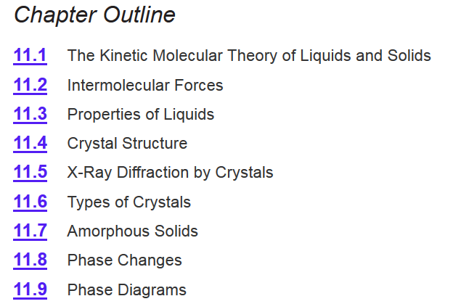
Chapter 11
Ch 11
Page 467

Slide 2
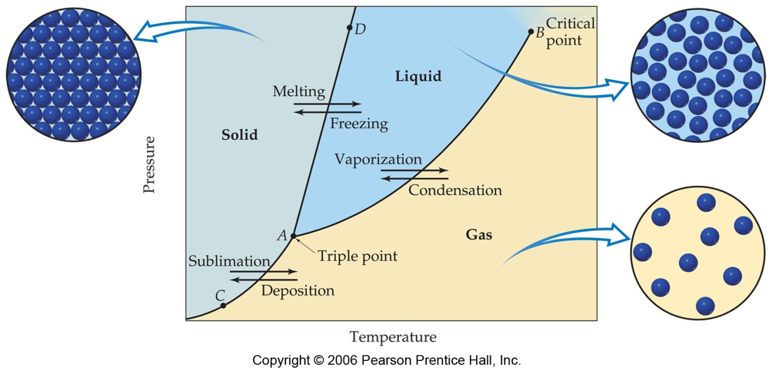
Phase Diagram
Important Notes:
Each line (AC, AB, and AD): two phases are in equilibrium.
B) The critical point: above this critical temperature and critical pressure the liquid and vapor are indistinguishable from each other.
Below A: the point below which the substance cannot exist as a liquid .
A) The triple point: the point at which all three states are in equilibrium.

Slide 3
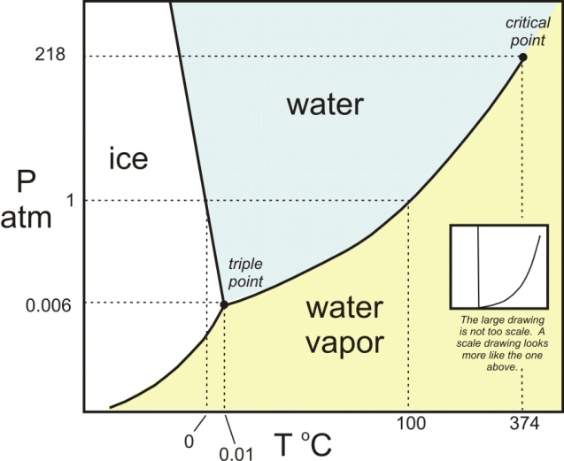
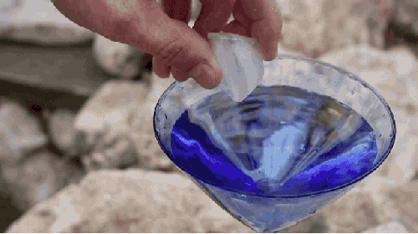
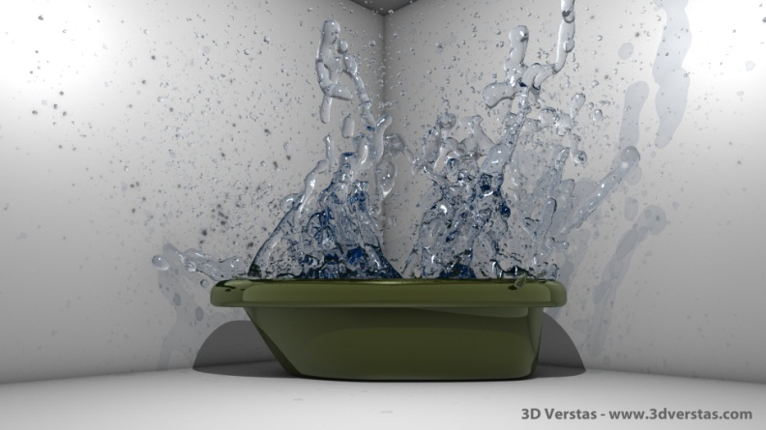
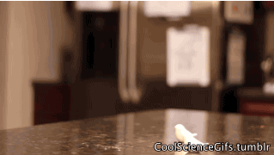
Supercooling/Superheating
Nucleation site- nucleation site can be thought of as an actual physical location that induces a phase change.
Heating or cooling in the absence of nucleation sites.
Supercooling- is the process of lowering the temperature of a liquid below its freezing point without becoming solid.
Superheating- is the phenomenon in which a liquid is heated to a temperature higher than its boiling point, without boiling.
https://www.youtube.com/watch?v=ZAqqpDF4bVw

Slide 4
Chapter 11
Ch 11
Page 467

Slide 5
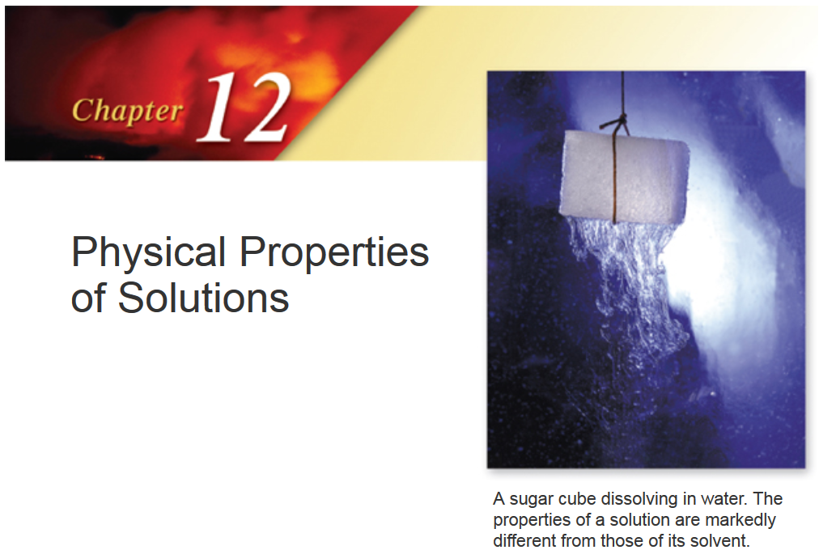

Slide 6
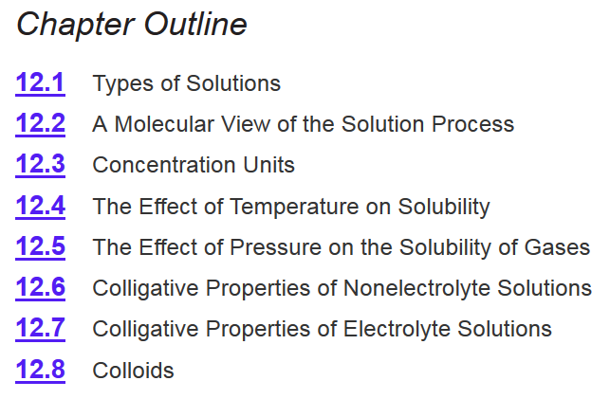
Chapter 12
Ch 12
Page 520

Slide 7
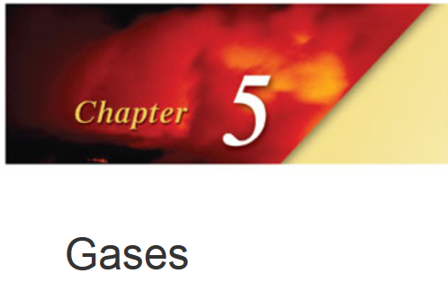
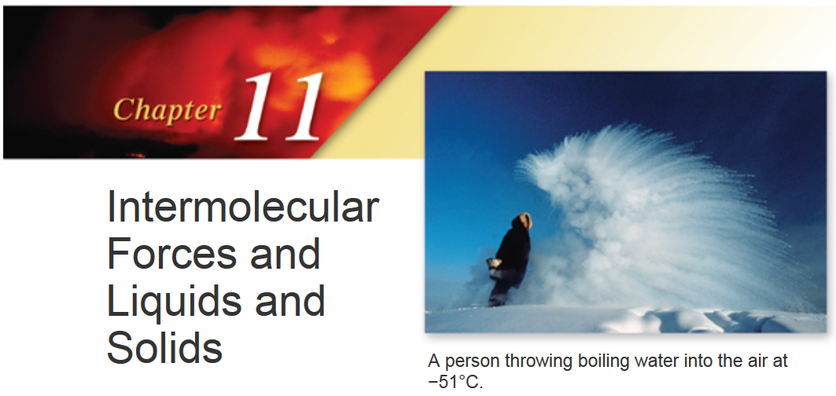
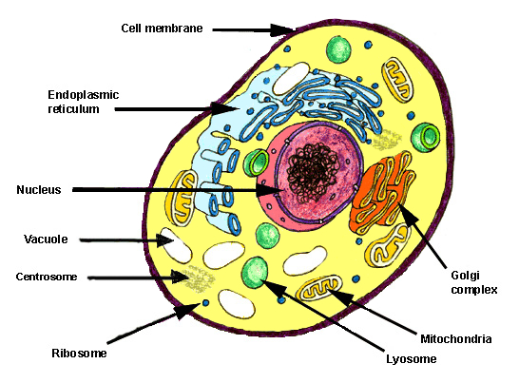
Why solutions matter.
A solution is a homogenous mixture of two or more substances
Used in:
Synthetic chemistry
Dilutions
Blood plasma
Synaptic Transmission
DNA replication
Because they are “simple.”

Slide 8
Relevant Terminology
Solutions are homogeneous mixtures of two or more substances.
  Dissolving medium is called the solvent
  Dissolved species are called the solute
Dissolution- the process by which a solute forms a solution in a solvent.
  Upon dissolution, solute molecules are surrounded (solvated) by solvent molecules
  Solvent molecules have to rearrange around solute molecules
Soluble – substance that dissolves another substance
Insoluble – substance that does not dissolve another substance
Miscible – liquids that are completely soluble in each other
Immiscible – liquids that are not soluble in each other

Slide 9
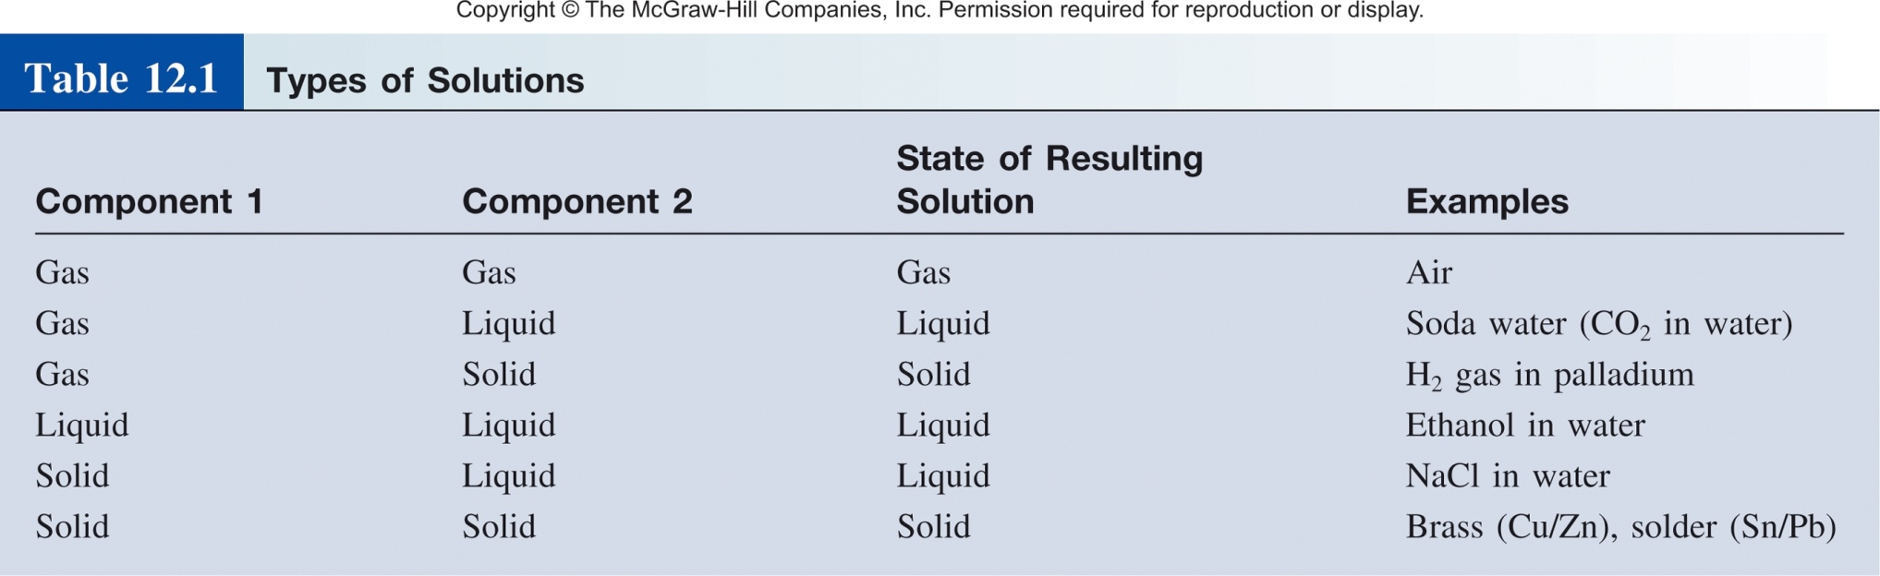
Types of Solutions
The solute is(are) the substance(s) present in the smaller amount(s)
The solvent is the substance present in the larger amount
Ch 12.1
Page 521

Slide 10


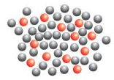
Molecular view of Dissolution
Three types of interactions in the dissolution process:
solvent-solvent interaction
solute-solute interaction
solvent-solute interaction
If
solvent-solute interaction < solute-solute + solvent-solvent
then no mixing:
+
=
+
If
solvent-solute interaction > solute-solute + solvent-solvent
then there is mixing:
Ch 12.2
Page 522
+
=

Slide 11
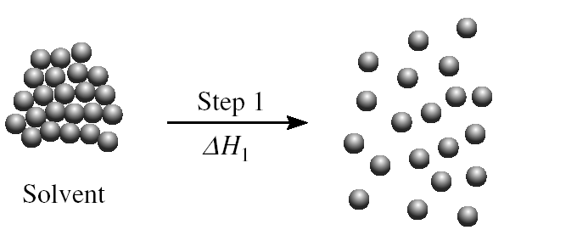
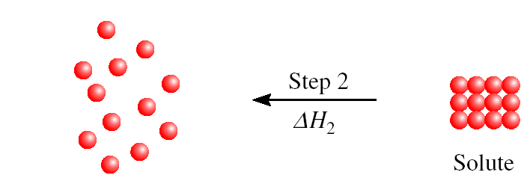
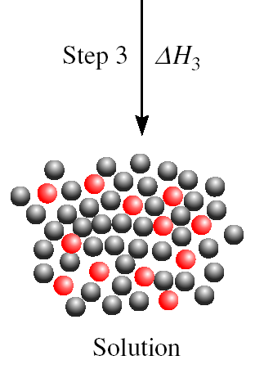
Molecular/Energetic view of Dissolution
ΔH₂ + ΔH₃ are positive
ΔH_{soln} = ΔH₁ + ΔH₂ + ΔH₃
Heat of solution (ΔH_{soln})
ΔH_{soln} > 0, endothermic (energetically unfavorable)
ΔH_{soln} < 0, exothermic (energetically favorable)
Intermolecular Forces!

Slide 12

Flavors of Intermolecular Forces
dipole-dipole
ion-dipole
Induced/instantaneous dipole:
  ion-induced dipole
  dipole-induced dipole
  instantaneous dipole-induced dipole
hydrogen bonding
Ch 11.2
Page 470

Slide 13
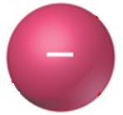
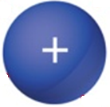



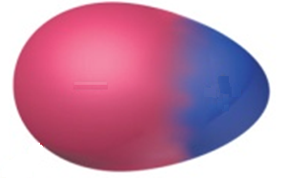
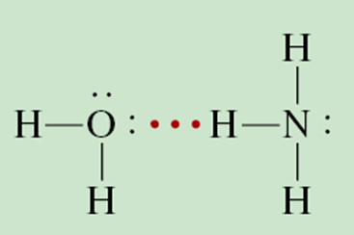
General “Rules” of Solubility
“like dissolves like”
  Nonpolar molecules are soluble in nonpolar solvents.
  Ions and polar molecules are soluble in polar solvents.
  Special Case of polar-polar: Hydrogen bonding solutes are soluble in hydrogen bonding solvents.
Polar-protic solvent
Ch 12.2
Page 523

Slide 14
Solutions of Nonpolar Liquids
Nonpolar molecules interact only through weak dispersion forces (instantaneous dipole-induced dipole).
  For example, carbon tetrachloride and benzene are very soluble/miscible.
  N₂ is more soluble in cyclohexane than it is in water.
N₂

Slide 15
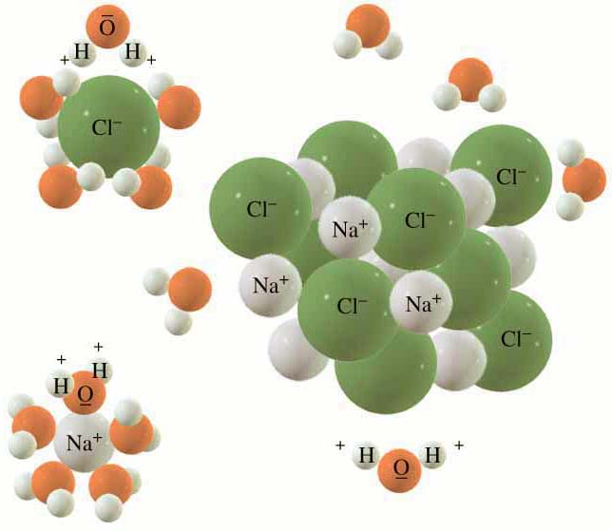
Ionic Solids in Liquid (ion-dipole)
Dissolution for NaCl in H₂O is a competition between:
  Solute-solute attractions
    crystal lattice energy for ionic solids
  Solvent-solvent attractions
    dipole-diple
    H-bonding
  Solute-solvent attractions
    Ion-dipole interaction

Slide 16
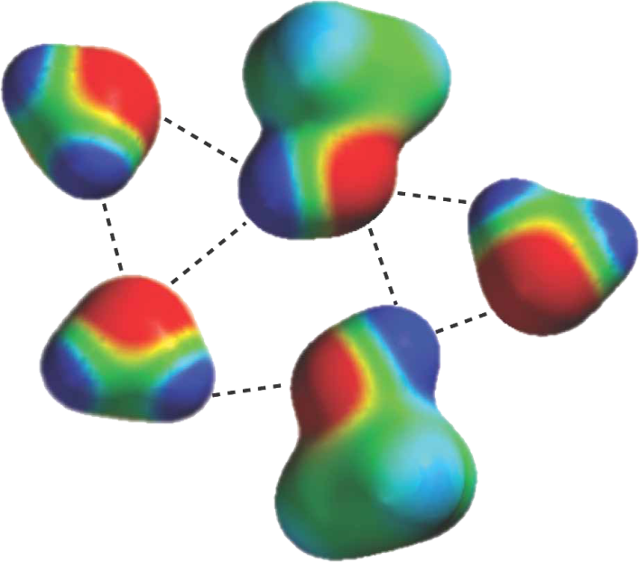
Protic Polar Solvents
  Hydrogen bonding
  Especially important in aqueous solutions
  The primary factor in the solubility of many biological compounds (sugars, aminoacids, etc.)
Water-methanol mixture

Slide 17
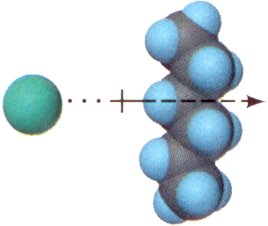

Less Favorable Solutions
Ion - induced dipole forces
  Account for the solubility of ionic salts
  in less polar solvents
  (Example: Cl– in hexane, C₆H₁₄)
Dipole - induced dipole forces
  Contribute to the solubility of nonpolar molecules in polar solvents (N₂ in H₂O)
Cl–
H₂O
N₂

Slide 18
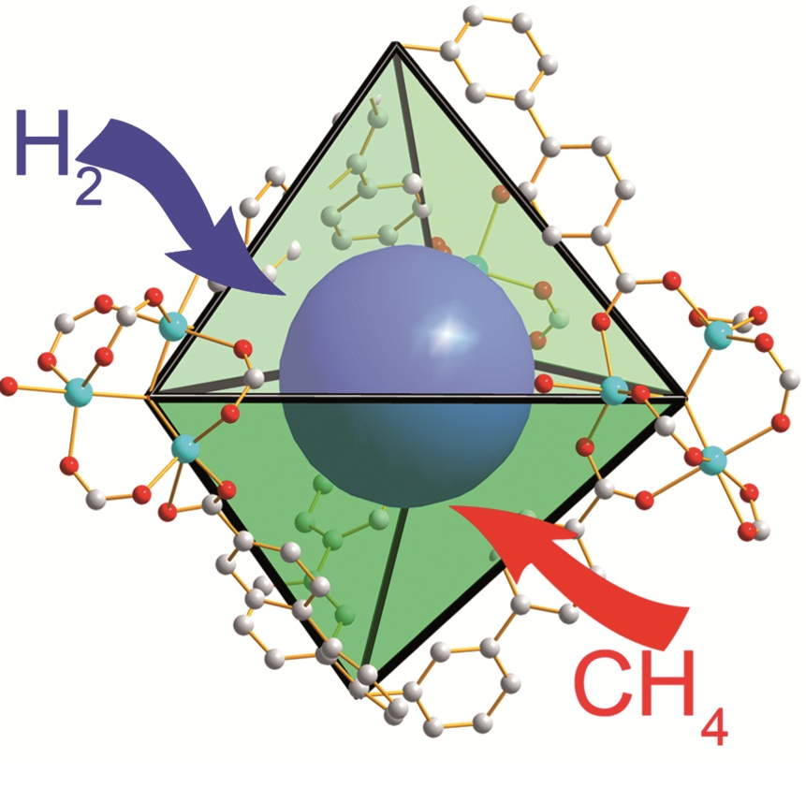
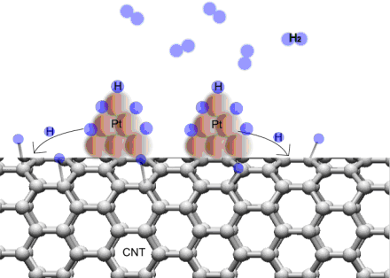
Other Types of Solutions
Gases are infinitely soluble in one another.
Gases usually are only sparingly soluble in solids.
  Hydrogen and Platinum ̶ Gasses in MOFs

Slide 19
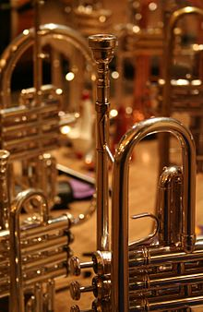
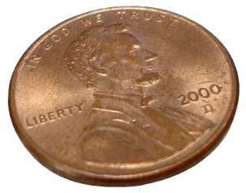
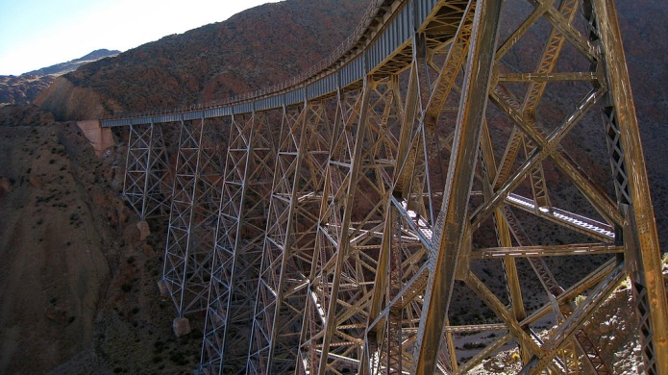
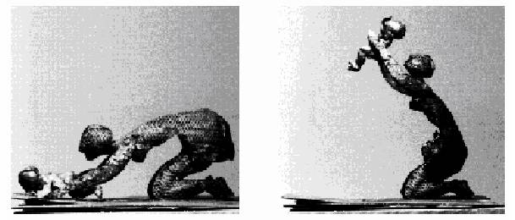
Other Types of Solutions
Alloys are the most important solid-solid solutions
  These solutions have been known for a long time
  They are crucial to the majority of modern technologies.
Brass
Steel
97.5% Zn, 2.5% Cu
Memory Metal
Fe, C
Olivier Deschamps,
'Espoir Desespoir'
Nitinol (NiTi-Alloy)

Slide 20
Types Of Alloys
ALLOY | COMPONENT | USES
Babbitt | Tin, antimony, copper | Bearings
Bell metal | Copper, tin | Bells
Coinage metals | Copper, tin, zinc | Coins
16 karat gold | Gold, copper, silver | Jewelry
Sterling | Silver, copper | Jewelry, flatware
Nichrome | Nickel, iron, chromium, manganese | Heating elements

Slide 21
12.1
Predict the relative solubilities in the following cases:
Bromine (Br₂) in benzene (C₆H₆, μ = 0 D) and in water (μ = 1.87 D)
KCl in carbon tetrachloride (CCl₄, μ = 0 D) and in liquid ammonia (NH₃, μ = 1.46 D)
formaldehyde (CH₂O) in carbon disulfide (CS₂, μ = 0 D) and in water

Slide 22
12.1
Solution
Br₂ is a nonpolar molecule and therefore should be more soluble in C₆H₆, which is also nonpolar, than in water. The only intermolecular forces between Br₂ and C₆H₆ are dispersion forces.
(b) KCl is an ionic compound. For it to dissolve, the individual K⁺ and Cl⁻ ions must be stabilized by ion-dipole interaction. Because CCl₄ has no dipole moment, KCl should be more soluble in liquid NH₃, a polar molecule with a large dipole moment.
(c) Because CH₂O is a polar molecule and CS₂ (a linear molecule) is nonpolar, the forces between molecules of CH₂O and CS₂ are dipole-induced dipole and dispersion. On the other hand, CH₂O can form hydrogen bonds with water, so it should be more soluble in that solvent.

Slide 23
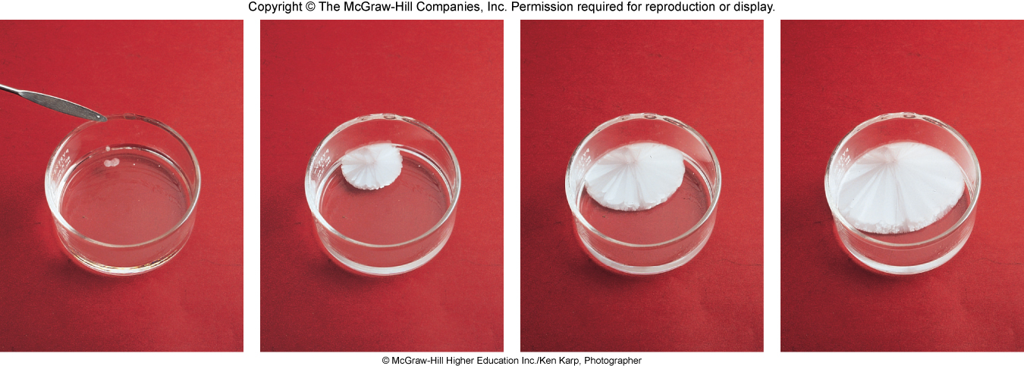
How Much is in Solution?
    Unsaturated solutions contains less solute than the solvent has the capacity to dissolve at a specific temperature.
Saturated solutions contains the maximum amount of a solute that will dissolve in a given solvent at a specific temperature.
    Supersaturated solutions contains more solute than is present in a saturated solution at a specific temperature.

Slide 24
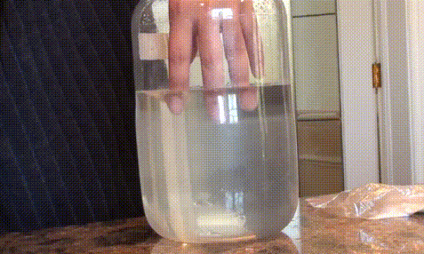
How Much is in Solution?
    Supersaturated solutions contains more solute than is present in a saturated solution at a specific temperature.
Sodium Acetate in water

Slide 25
Concentration Units
Percent by mass
mass of solute
% by mass =
x 100%
mass of solution
Mole Fraction (Χ)
moles of A
X_{A} =
sum of moles of all components
Molarity (M)
moles of solute
M =
liters of solution
Molality (m)
moles of solute
Ch 12.2
Page 525
m =
mass of solvent (kg)

Slide 26
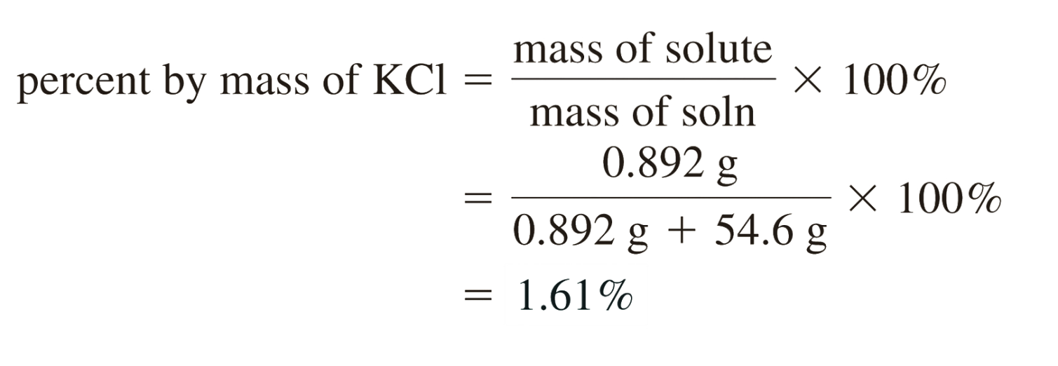
Percent by Mass
mass of solute
% by mass =
x 100%
mass of solution
A sample of 0.892 g of potassium chloride (KCl) is dissolved in 54.6 g of water. What is the percent by mass of KCl in the solution?
Useful for Thermogravametric Analysis
(/ 100 = ppm, ppb, etc.)

Slide 27
Mole Fraction
moles of A
X_{A} =
sum of moles of all components
0.100 mole of NaCl is dissolved into 100.0 grams of pure H₂O. What is the mole fraction of NaCl? (H₂O is 18 g/mol)
100.0 g / 18.0 g mol¯¹ = 5.56 mol of H₂O
Total mol = 5.56 mol of H₂O + 0.100 mol NaCl= 5.66 mol
Mole fraction of NaCl = 0.100 mol / 5.66 mol = 0.018
What is the mole fraction of H₂O?

Slide 28
Molarity vs Molality
Molarity (M)
Molality (m)
moles of solute
moles of solute
M =
m =
liters of solution
mass of solvent (kg)
Easier to measure large volumes.
Only requires a good balance.
Temperature independent.
Ch 4.5
Page 145

Slide 29
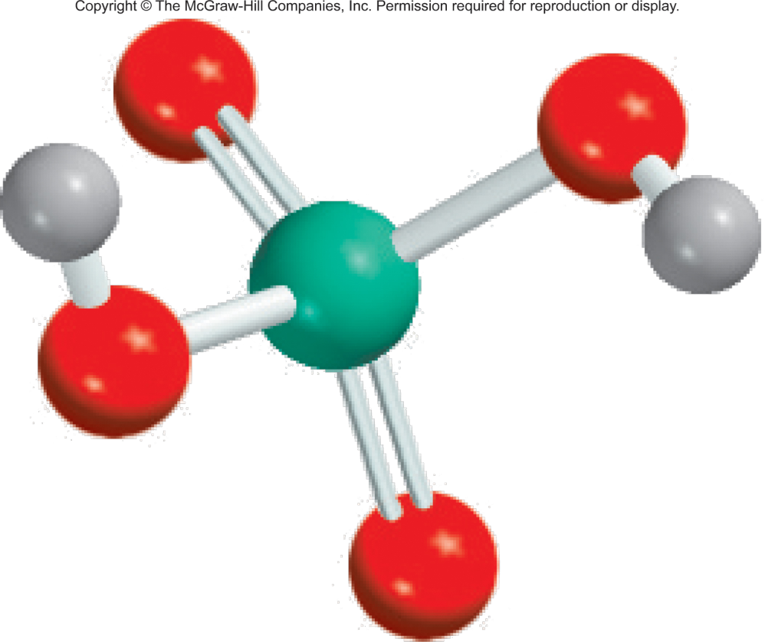
12.3
Calculate the molality of a sulfuric acid solution containing 24.4 g of sulfuric acid in 198 g of water.
The molar mass of sulfuric acid is 98.09 g/mol.
moles of solute
m =
mass of solvent (kg)

Slide 30
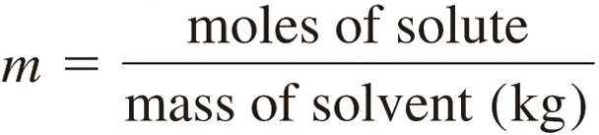
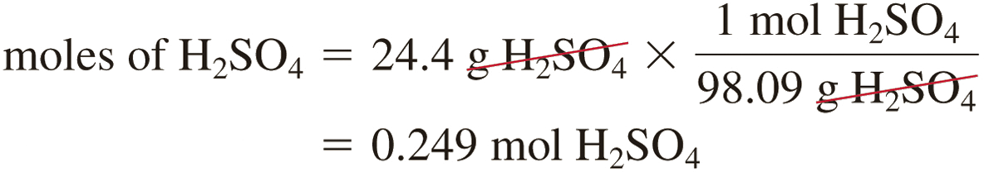
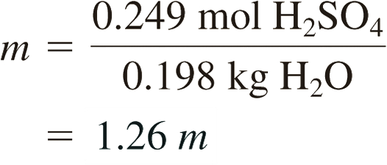
12.3
Solution The definition of molality (m) is
First, we find the number of moles of sulfuric acid in 24.4 g of the acid, using its molar mass as the conversion factor.
The mass of water is 198 g, or 0.198 kg. Therefore,

Slide 31
Concentration Units
Percent by mass
mass of solute (g)
% by mass =
x 100%
mass of solution (g)
Mole Fraction (Χ)
moles of A (mol)
X_{A} =
sum of moles of all components (mol)
Molarity (M)
moles of solute (mol)
Relevant conversions:
Molecular weight (g/mol)
Density (g/mol)
1000 g = 1 kg
M =
liters of solution (L)
Molality (m)
moles of solute (mol)
Ch 12.2
Page 525
m =
mass of solvent (kg)

Slide 32
Chapter 12
Ch 12
Page 520

Slide 33
Solubility Temp Dependence
Solubility- the maximum amount of a solute that will dissolve in a given quantity of solvent at a specific temperature.
Solubility is a temperature dependent phenomena.
General Summary:
Solids dissolved in liquids Gases dissolved in liquids
Sol.
Sol.
Tº
Tº
As Tº , solubility
As Tº , solubility
Ch 12.4
Page 529

Slide 34
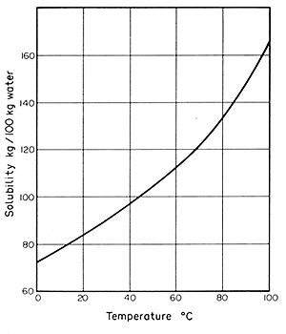
Liquid-Solid Solubility Curves
The relationship between solubility and temperature can be represented by a solubility curve.
Each point in the solubility curve represents a saturated solution.
Any point below a curve represents an unsaturated solution.
Any point above the curve would be a super saturated solution.
Super saturated
Saturated
Unsaturated

Slide 35
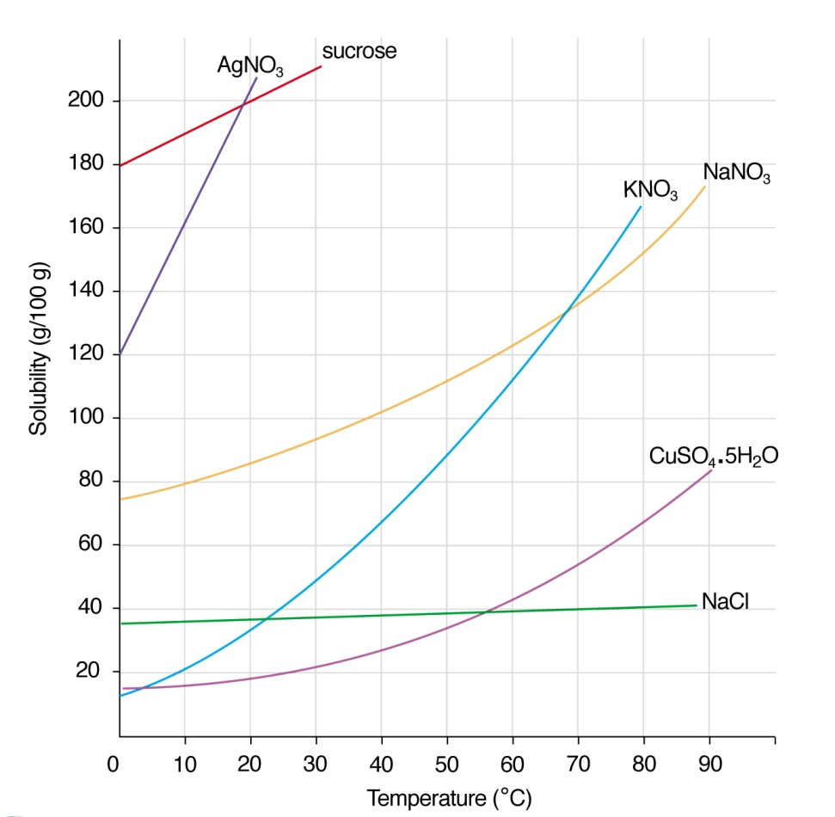
Liquid-Solid Solubility Curves
Solubility: Sucrose > NaNO₃ > NaCl
Generally: solubility of solids in liquids increases with increasing temperature…

Slide 36
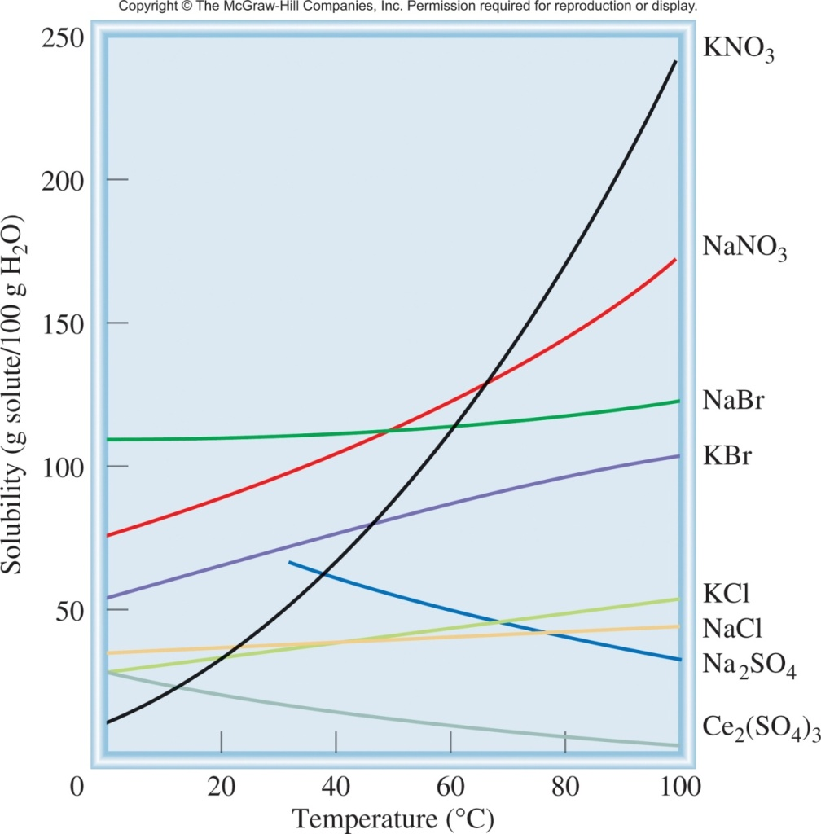
But not always
solubility increases with increasing temperature
+ ΔH_{soln} (endothermic)
solute + solvent + heat
solution
increasing temp
solubility decreases with increasing temperature
− ΔH_{soln} (exothermic)
solute + solvent
solution + heat
increasing temp

Slide 37
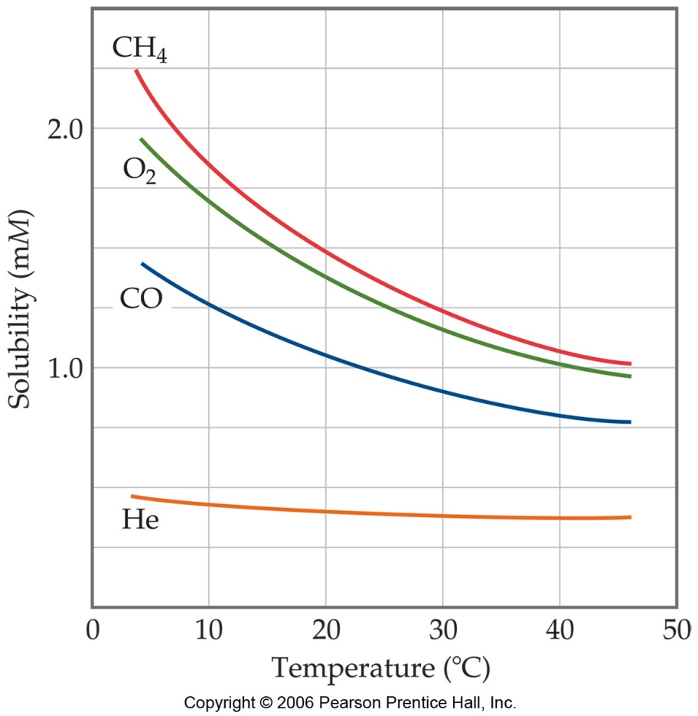
Liquid-gas Solubility Curves
solubility of gasses “always” decreases with increasing temperature
Carbonated beverages go “flat” as they warm due to a decreased solubility of dissolved CO₂
Bubbles form on the inside wall of a cooking pot when water is heated even though the temperature is well below boiling
Thermal pollution of lakes and streams causes low oxygen levels in deeper layers

Slide 38
Example Problem
An 80 g sample of NaNO₃ is added to 200g of H₂O at 20°C. Use the solubility curve in Figure 11.1 to calculate how much more NaNO₃ needs to be added to make the solution saturated with NaNO₃ at 20°C.
80 g
200 g
40 g NaNO₃
100 g H₂O
=

Slide 39
Chapter 12
Ch 12
Page 520

Slide 40
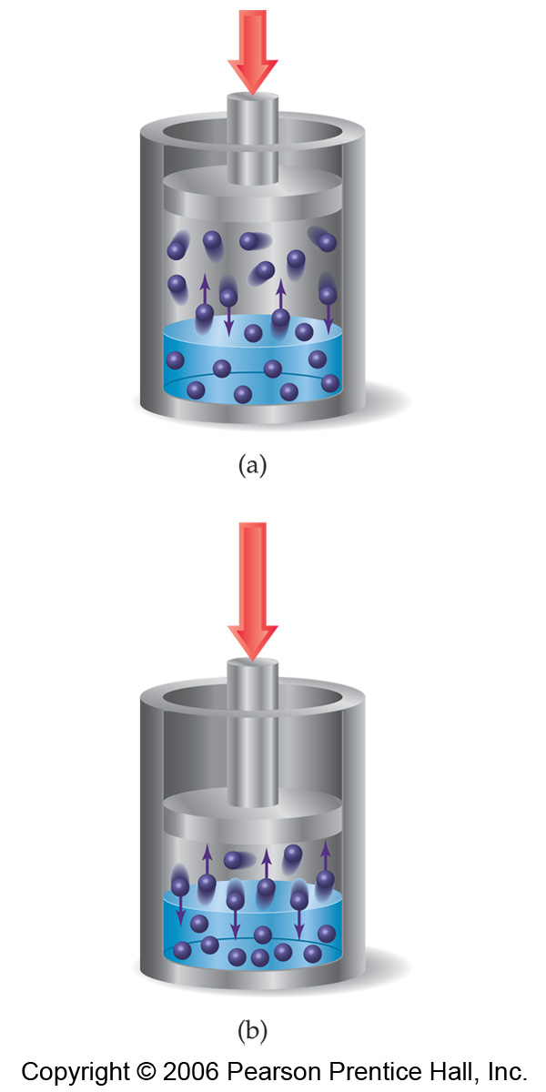
Pressure and Solubility
The solubilities of solids and liquids are not affected appreciably by pressure
When the pressure of a gas is increased, the rate at which gas molecules enter the solution increases
The concentration of solute molecules at equilibrium increases in proportion to the pressure
So the solubility of a gas increases with pressure

Slide 41
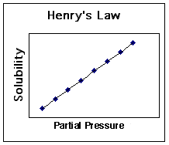
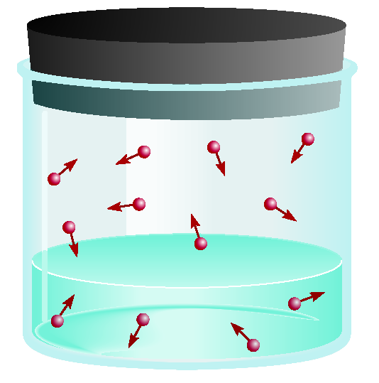
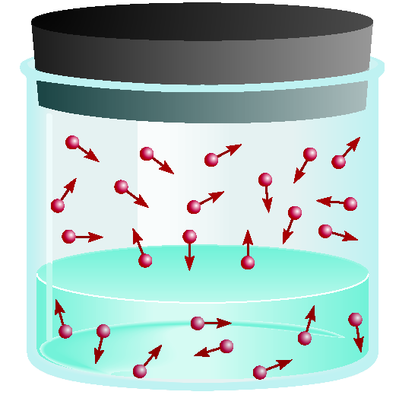
Pressure and Solubility of Gases
The solubility of a gas in a liquid is proportional to the pressure of the gas over the solution (Henry’s law).
c is the concentration (M) of the dissolved gas
c = kP
P is the pressure of the gas over the solution
k is a constant for each gas (mol/L•atm) at a given temperature
low P
high P
low c
high c

Slide 42
12.6
The solubility of nitrogen gas at 25°C and 1 atm is 6.8 × 10⁻⁴ mol/L. What is the concentration (in molarity) of nitrogen dissolved in water under atmospheric conditions? The partial pressure of nitrogen gas in the atmosphere is 0.78 atm.
c is the concentration (M) of the dissolved gas
c = kP
P is the pressure of the gas over the solution
k is a constant for each gas (mol/L•atm) at a given temperature

Slide 43
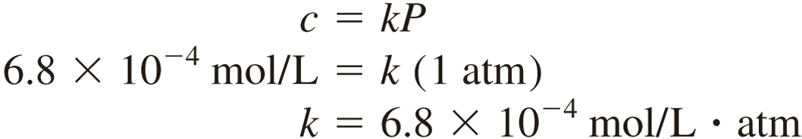
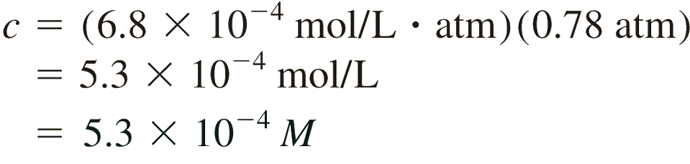
12.6
Solution Step 1) you have c and P, now calculate k:
Step 2) k is and P (0.78) are known, now calculate c:
The decrease in solubility is the result of lowering the pressure from 1 atm to 0.78 atm.

Slide 44
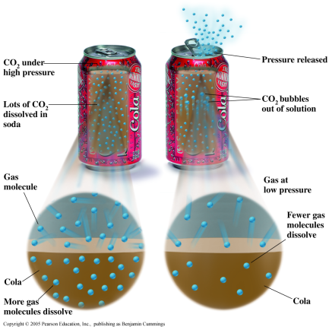
Pressure and Solubility
Soft drink bottled under CO₂ pressure greater than 1 atm
When the bottle is opened, partial pressure of CO₂ above the solution decreases
Solubility of CO₂ decreases -> bubbles
Bubbles until it reaches equilibrium

Slide 45
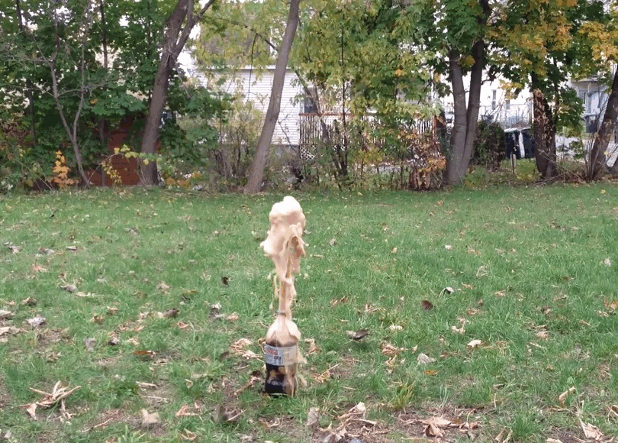
Pressure and Solubility
  Variables:
  dipole-dipole of water
  surface tension
  CO₂ concentration
  nucleation sites
  surface area
Bubbles form when CO₂ molecules congregate next to nucleation sites, which break up the network of water molecules. When enough are gathered, they form a bubble.
Mentos- rough high surface area = more nucleation sites
gum arabic = reduces surface tension of water

Slide 46
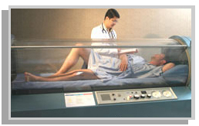
The Bends
Deeper diving has higher pressures
  Must use breathing tank (atm = 78% N₂, 21% O₂, etc.)
  Deep sea high pressure forces N₂ to dissolve in higher amounts in blood.
If ascension is too fast, lower external pressure causes N₂ to start bubbling out of blood too quickly
  Rupturing of arteries
    Excruciatingly painful death
    Must be rushed to hyperbaric chamber
Tanks now don’t use N₂, but He
  He is small and can diffuse
  through tissue quicker.

Slide 47

Exceptions to Henry’s Law
c = kP
Reactions with the solution:

Slide 48
Chapter 12
Ch 12
Page 520

